Slide 1
State Board of Education
Office of Educator Licensure and Effectiveness

Slide 2
CONTACT INFORMATION
Yenetta.Harper@sboe.ohio.gov
Director, Office of Educator Licensure and Effectiveness
Curtis.Hewitt@sboe.ohio.gov
Associate Director, Office of Educator Licensure and Effectiveness
James.Wightman@sboe.ohio.gov
Associate Director, Office of Educator Licensure and Effectiveness

Slide 3

2025 Ohio Teacher of the Year Cohort
​
Notes:
​217
The Ohio Teacher of the Year program annually identifies exceptional teachers statewide and celebrates their effective work in and out of the classroom. Each year, the Ohio Teacher of the Year nominations are open February through early April. School administrators, colleagues, community members, parents or students may submit a nomination for one or multiple teachers from a school or district. State Board of Education members assist with the recognition program activities. Following an in-depth nomination, application and selection process this year, 11 State Board District Teachers of the Year were selected for 2026.

Slide 4
2025 Ohio Teacher of the Year
​
Christopher Monsour
High School Science teacher
Columbian High School
Tiffin City School District
Notes:
​217
The Ohio Teacher of the Year program annually identifies exceptional teachers statewide and celebrates their effective work in and out of the classroom. Each year, the Ohio Teacher of the Year nominations are open February through early April. School administrators, colleagues, community members, parents or students may submit a nomination for one or multiple teachers from a school or district. State Board of Education members assist with the recognition program activities. Following an in-depth nomination, application and selection process this year, 11 State Board District Teachers of the Year were selected for 2026.

Slide 5
Reminders
Interim Resident Educator License
Interim Principal License
Pre-Service Teacher Permit
Application and Background Check Process Improvements

Slide 6
DUAL LICENSE
CURRENTLY
Grades 4-9 (Mild/Moderate)
Grades 7-12 (Mild/Moderate)
Adding
Grades PK-5
All three will be Mild/Moderate/Intensive)
Plan is for State Board to vote In December

Slide 7
Testlets
#007 Biology
#190 Foundations of Reading
#020 English Language Arts
#024 Integrated Science
#025 Integrated Social Studies
#027 Mathematics
PK-8 Content Assessment

Slide 8
About assessments with testlets
An assessment composed of testlets reports
a score on a 100-300 scale
a passing status
Once a testlet score is reported, its contribution to passing the assessment will be recorded.
Passing the assessment requires
having testlet results that, together, produce an assessment-level score ≥ 220
Notes:
A candidate can
take the full assessment in one sitting, or
take/retake one or more testlets separately
Testlets break up the content so a examinee can
effectively focus preparation
line up taking a testlet with their opportunity to learn that content within preparation

Slide 9
Framework
 |  | weight | Testing time | Seat time | Scale
708 | Mathematics | 100% | 3:30 | 3:45 | 100-300
307 | Real Numbers, Complex Numbers, Vectors, and Matrices | 20% | 45 | 60 | 20-60
308 | Algebra and Functions | 30% | 60 | 75 | 30-90
309 | Measurement, Geometry, and Trigonometry | 30% | 60 | 75 | 30-90
310 | Statistics and Probability | 20% | 45 | 60 | 20-60

Slide 10
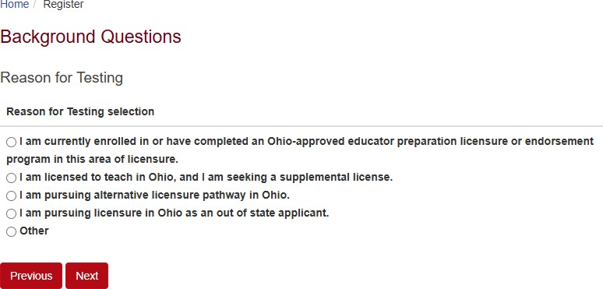
Ohio Assessments for Educators Registration Background Questions

Slide 11
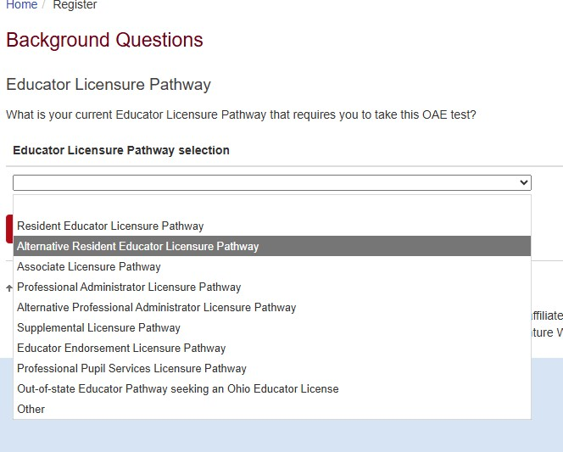

Slide 12
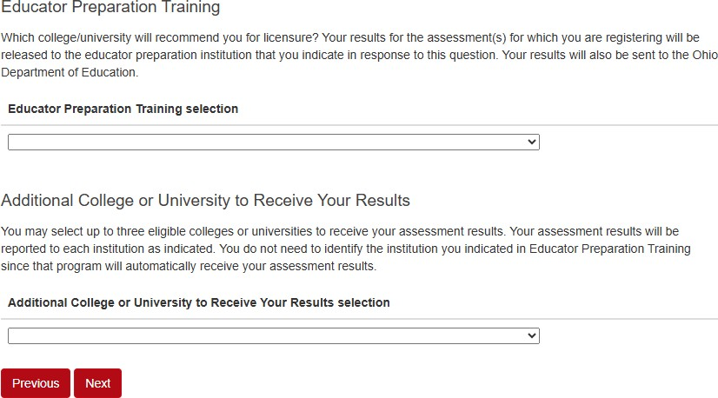

Slide 13
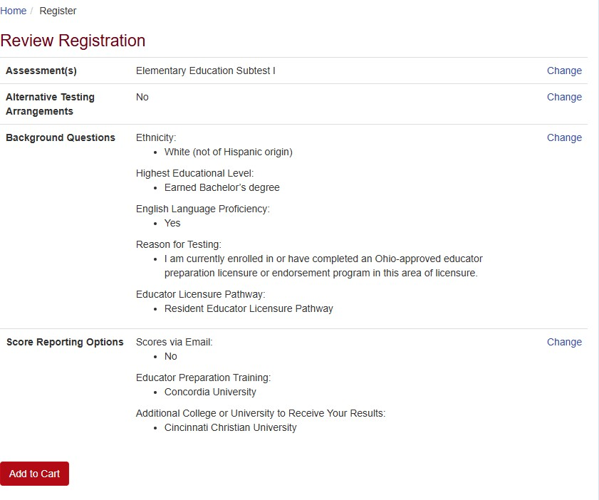

Slide 14
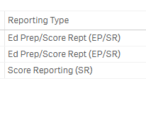
OAE Passage Rates
Ed Prep/Score Report versus Score Reporting

Slide 15



Stay Connected
@SBOEOhio
linkedin.com/company/state-board-of-education-of-ohio
Visit our website to sign up for our email subscription service to receive updates and important information on the topics you want.

